Slide 1
Energy
in
Reactions

Slide 2
During a chemical reaction the substances involved can either
give out energy or
absorb energy

Slide 3
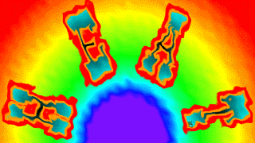
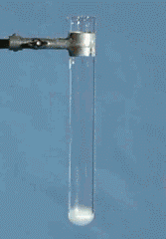
A chemical reaction which gives out energy is said to be Exothermic.
Eg. An M&M is placed into molten potassium chlorate and the sugar is oxidized.

Slide 4

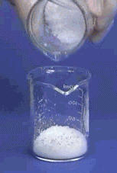
A chemical reaction which absorbs energy is said to be Endothermic.
Eg. Barium hydroxide & ammonium chloride react absorbing so much energy that the water on the board is frozen.

Slide 5

This is because during chemical reactions some bonds are being broken and some are being formed.

Slide 6
Whether the reaction is Exothermic or Endothermic depends the amounts of energy absorbed in breaking bonds in the reactants compared to the amount of energy released in forming bonds in the product.
If
energy absorbed in breaking bonds
energy released in forming bonds
Reaction is Endothermic
>
If
energy absorbed in breaking bonds
energy released in forming bonds
Reaction is Exothermic
<

Slide 7
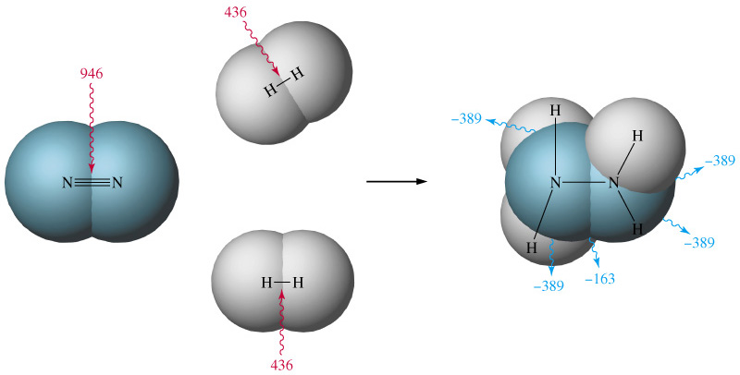
Eg 1. The values shown, in kilojoules per mole, are the amounts of energy absorbed in breaking bonds in the reactants, N₂ and H₂, and released in forming bonds in the product, N₂H₄.

Slide 8
Energy absorbed in breaking bonds = 946 + (2 x 436)
= 1818 kJ
Energy released in forming bonds = 163 + (4 x 389)
= 1719 kJ
Energy absorbed > Energy released ∴ Endothermic

Slide 9
Example 2. Hydrogen + Chlorine → Hydrogen Chloride
The symbol equation is: H_{2(g)} + Cl_{2(g)} → 2HCl_{(g)}
but think of it as: H-H + Cl-Cl → H-Cl + H-Cl
(where - represents the chemical bonds to be broken or formed)
the bond energies in kJ/mol are: H-H 436; Cl-Cl 242; H-Cl 431
Energy needed to break bonds = 436 + 242 = 678 kJ taken in
Energy released on bond formation = 431 + 431 = 862 kJ given out
The net difference between them = 862-678 = 184 kJ given out (92 kJ per mole of HCl formed)
More energy is given out than taken in, so the reaction is exothermic.

Slide 10
Example 3. Hydrogen Bromide → Hydrogen + Bromine
The symbol equation is: 2HBr_{(g)} → H_{2(g)} + Br_{2(g)}
but think of it as: H-Br + H-Br → H-H + Br-Br
(where - represents the chemical bonds to be broken or formed)
the bond energies in kJ/mol are: H-Br 366; H-H 436; Br-Br 193
Energy needed to break bonds = 366 + 366 = 732 kJ taken in
Energy released on bond formation = 436 + 193 = 629 kJ given out
The net difference between them = 732-629 = 103 kJ taken in (51.5kJ per mole of HBr decomposed)
More energy is taken in than given out, so the reaction is endothermic

Slide 11
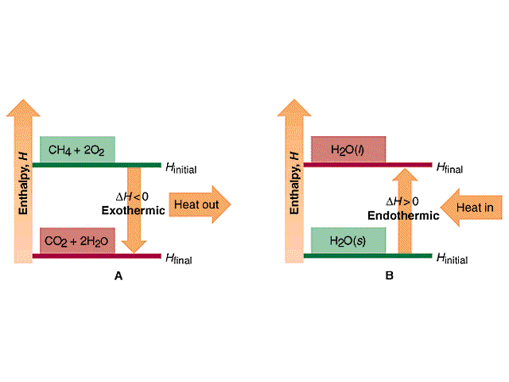
Graphically we can represent the Energy changes as follows :-
A. Burning methane gas is an exothermic reaction – heat is given out
B. Melting ice is an endothermic reaction – heat is absorbed

Slide 12
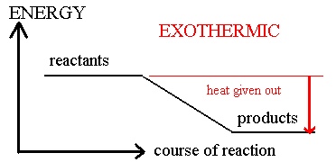
It is more common however, to use linear graphs to represent the Energy changes as follows :-
ΔH
For exothermic reactions ΔH is –ve (negative)

Slide 13
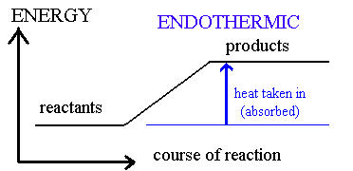
ΔH
For endothermic reactions ΔH is +ve (positive)

